Slide 1
Does RL-based training generalize?
Austen Liao, Kuleen Sasse

Slide 2
Two Axes
Catastrophic Forgetting
RL's Razor: Why Online Reinforcement Learning Forgets Less
Generalization
SFT Memorizes, RL Generalizes: A Comparative Study of Foundation Model Post-training

Slide 3
RL's Razor: Why Online Reinforcement Learning Forgets Less
Idan Shenfeld, Jyothish Pari, Pulkit Agrawal
Notes:
I’ll be introducing the first paper: RL’s Razor why online reinforcement learning forgets less
RL’s razor is a reference to occam’s razor which says that the simplest solution is often the best one and the author argue for something along those lines for RL

Slide 4
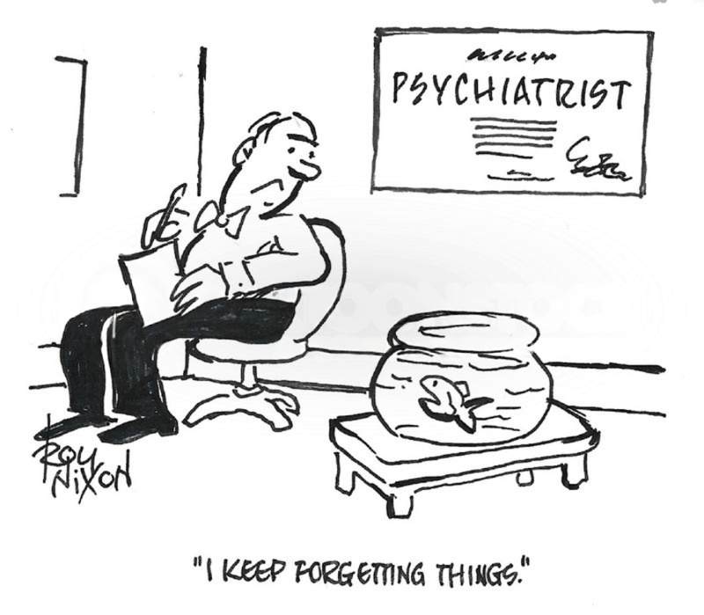
Introduction
Long lived agents continuously need to adapt to new situations
Forgetting previous blocks continual adaptation
Why does on-policy RL offer a path to preserve past skills over SFT and off-policy RL?
Notes:
Large foundations models are the backbone of modern AI
However, these models are static
If we want a future where models are long lived and continuously adapt
We do not want them to forget previous skills
But the learning of new skills often comes at a cost of losing previously learned skills right now especially with SFT
There might be some hope in terms of using on policy RL where we learn the policy using samples from the same policy and we resample as we go as it preserves old skills better than off policy RL where we learn a policy from a fixed set of samples from another policy and SFT
The main question is why does this happen?

Slide 5
Background
Foundation model post-training
SFT versus RL
Catastrophic forgetting
Notes:
Some background on the topic
As we know foundation models are often post trained through two big methods RL and SFT in order to turn their general purpose backbones into useable models for domain specific constraints and tasks
To do this we either use reinforcement learning and supervised finetuning
Many comparisons of RL and SFT have focused on the generalization gap between the two (like the next paper). This paper looks more towards catastrophic forgetting
Catastrophic forgetting where learning new information deteriorates previously acquired knowledge which impairs model from sequentially learning new tasks

Slide 6
Key points
On-policy RL adapts to new tasks with minimal forgetting
KL divergence predicts catastrophic forgetting
On-policy training drives the advantage
Notes:
There are 3 key points
On policy RL adapts to new tasks without catastrophic forgetting found in SFT
We can use KL divergence to predict the accuracy on the new task
On policy training is what drives this advantage

Slide 7
Minimal Forgetting - Experiment
SFT or On-Policy RL (w/o KL)
Measure
Avg. Performance on Other Tasks
Model
Train on
New Task
Notes:
The first main experiment to compare SFT and RL on catastrophic forgetting
They have a foundation model
They train it on the new task either using SFT or DR. GRPO without any KL regularization
And then they measure over the training process the accuracy on the new task
And the average accuracy across some other tasks that the model should know
They test two types of foundation models: large language models for text and Vision-language-action model for robotics

Slide 8
Minimal Forgetting (LLMs) - Experiment
SFT or On-Policy RL (w/o KL)
Measure
Avg. Performance on Other Tasks
Model
Train on
New Task
Qwen 2.5 3B Instruct
Math
Science Q and A
Tool Use
Hellaswag, TruthfulQA, MMLU, IFEval, Winogrande, HumanEval
Notes:
For LLMs: they choose Qwen
They then train the model on either math, Science Q and A, or Tool Use
While measuring the average performance on some classic benchmarking sets like Hellaswag - common sense inference,TruthfulQA - QA to get the model to be true, MMLU - general school knowledge, IFEval-instruction following, Winogrande - common sense reasoning, humaneval - coding

Slide 9
Minimal Forgetting (VLAs) - Experiment
SFT or On-Policy RL (w/o KL)
Measure
Avg. Performance on Other Task
Model
Train on
New Task
OpenVLA 7B
Can Picking Up Task
Opening and closing drawer
Notes:
For robotics they use openVLA 7B
they train a robot on learning to pick up a can
While measuring forgetting on its ability to open and close a drawer

Slide 10
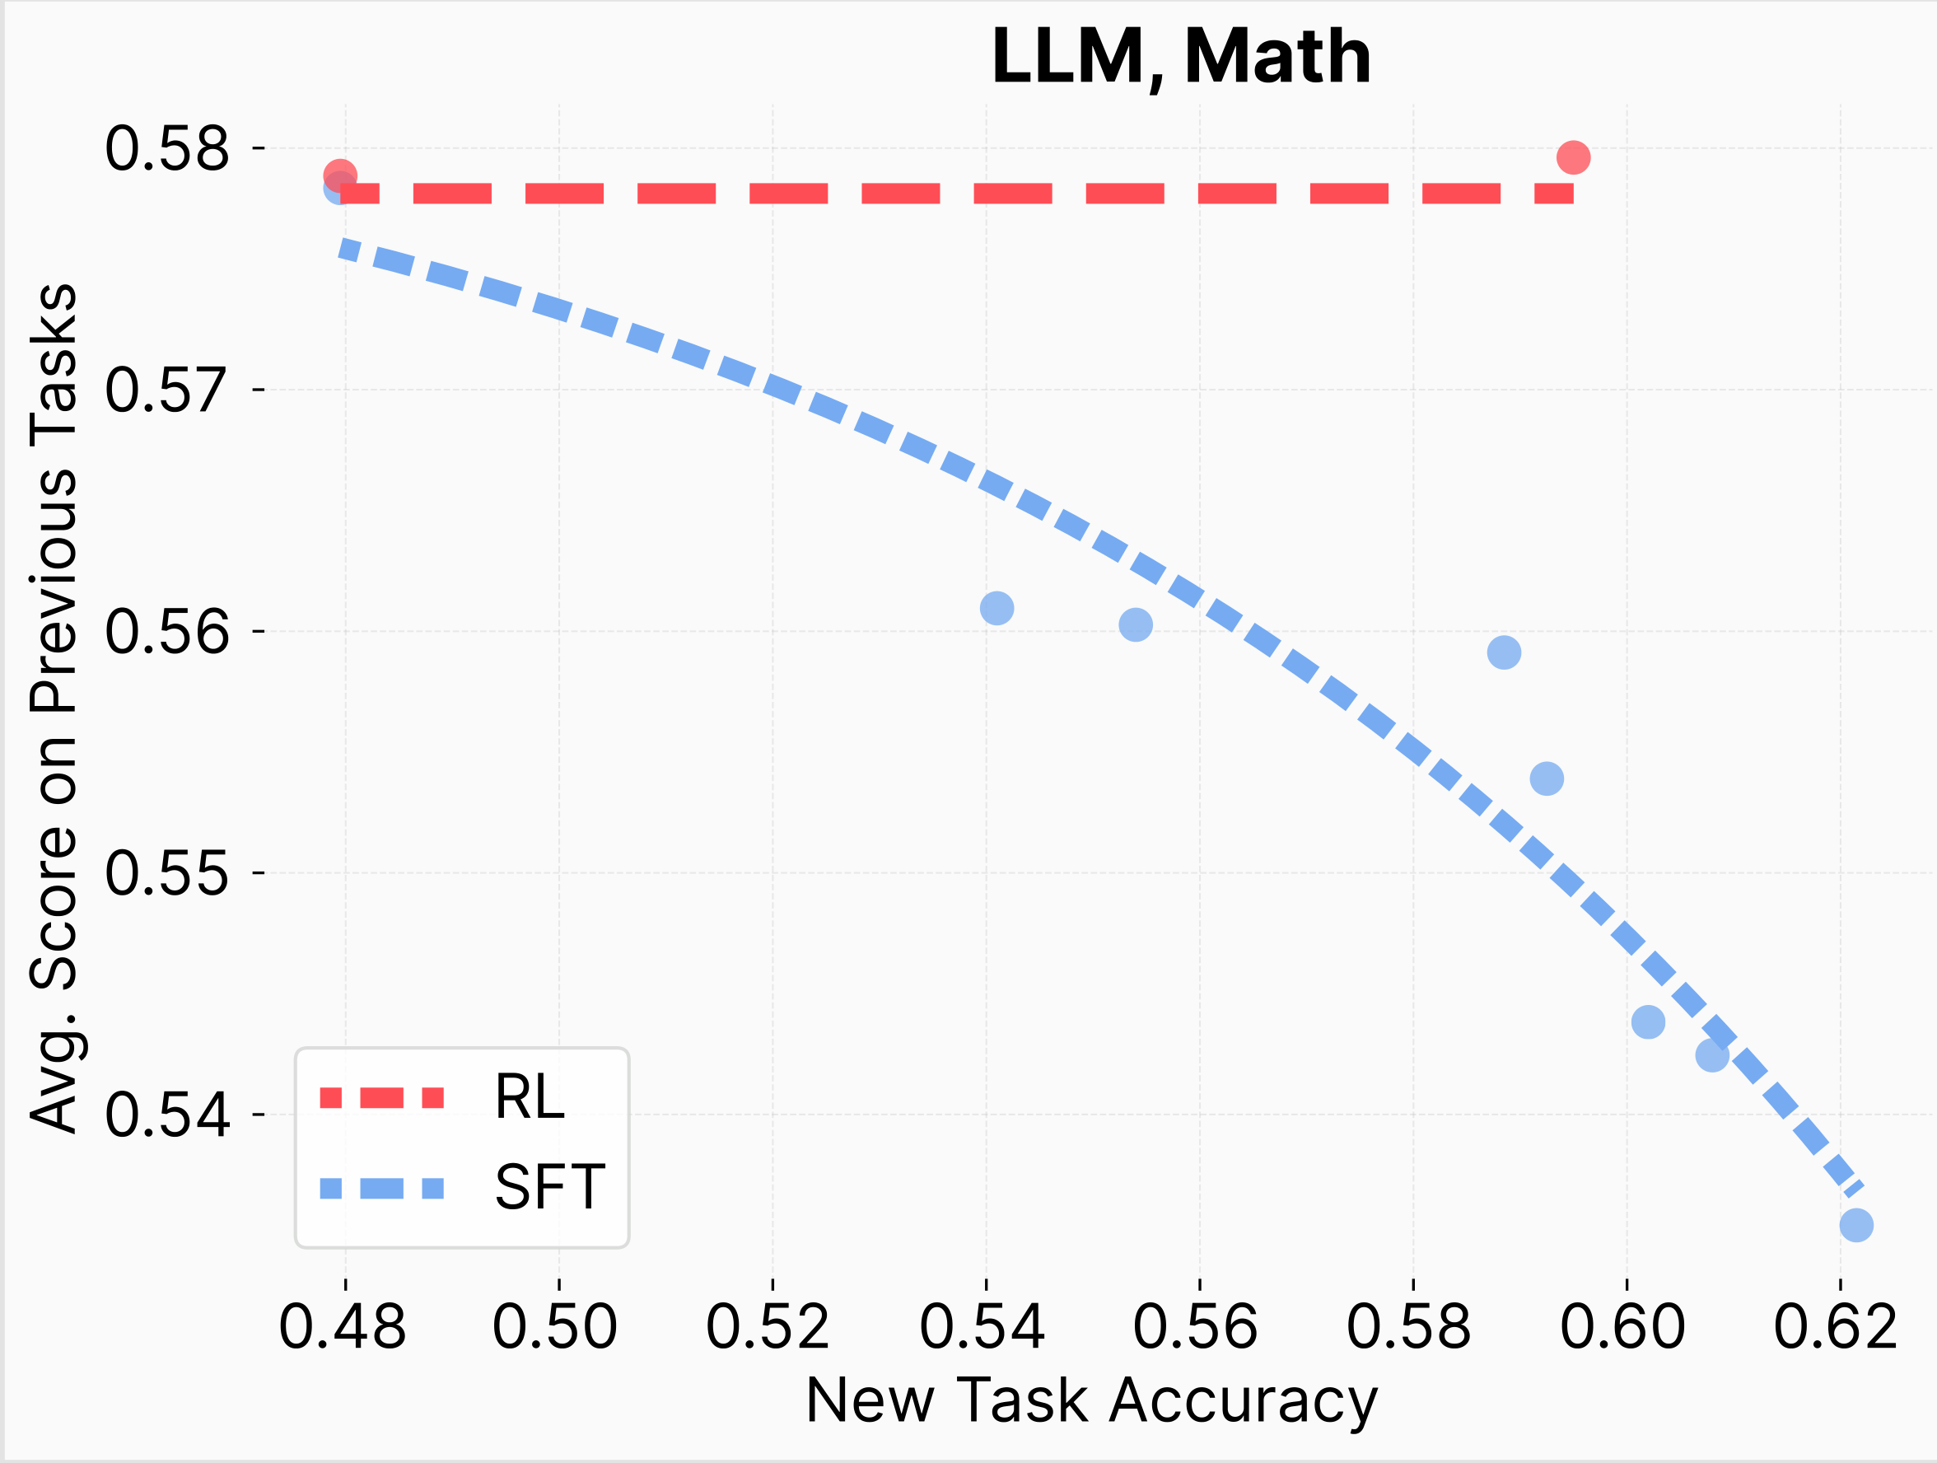
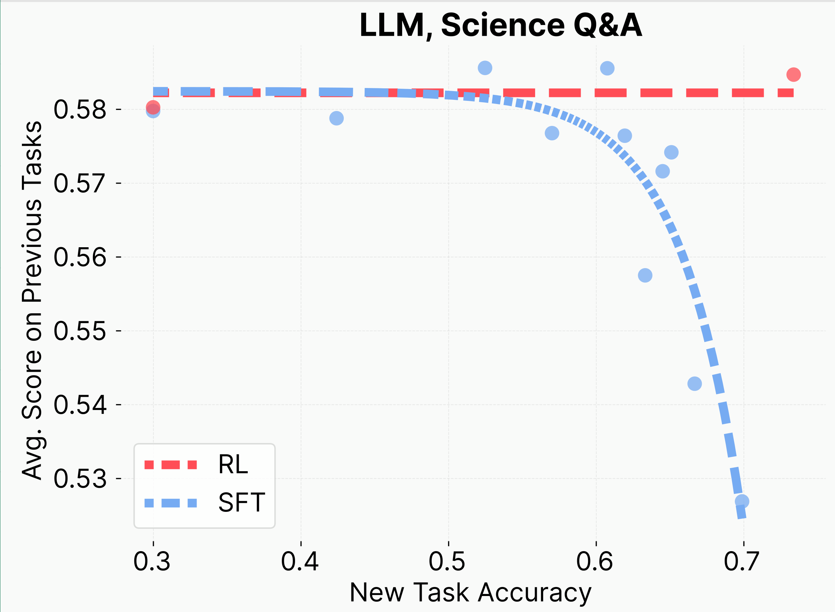
Minimal Forgetting - Results
RL does not forget!
Notes:
On the bottom we have the accuracy of the new task while we have the average score on the right
For Math we see that RL as new task accuracy increases, the avg score on previous tasks stay the same while sft as it improves on the new task it gets worse at the other tasks
Same thing happens but steeper for Science QA
They interpret this as RL not forgetting

Slide 11
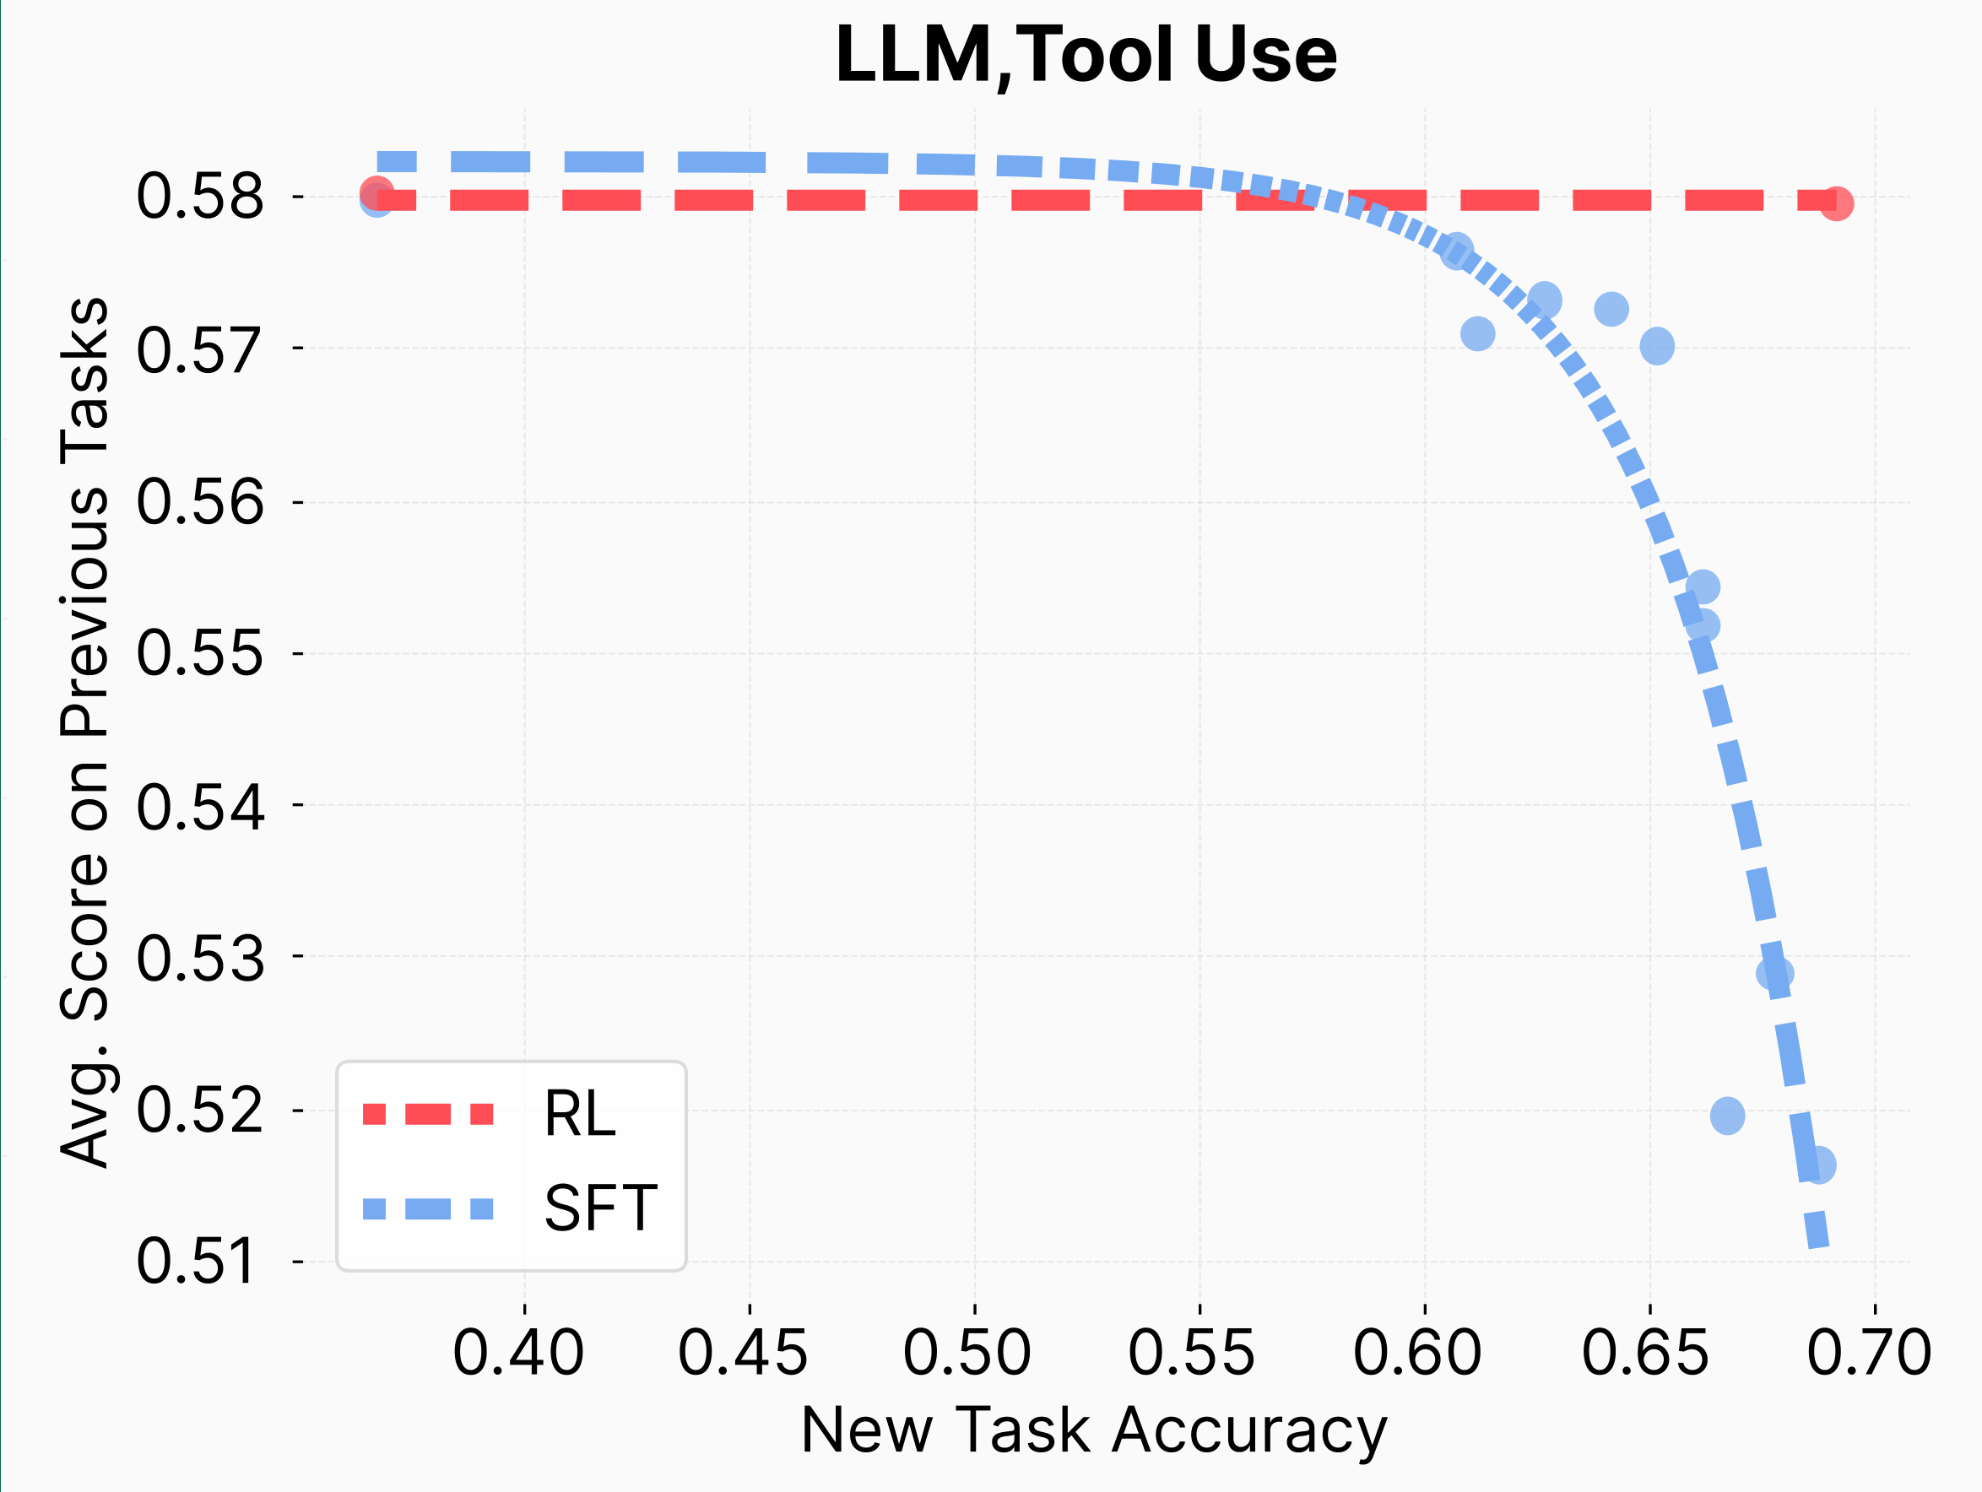
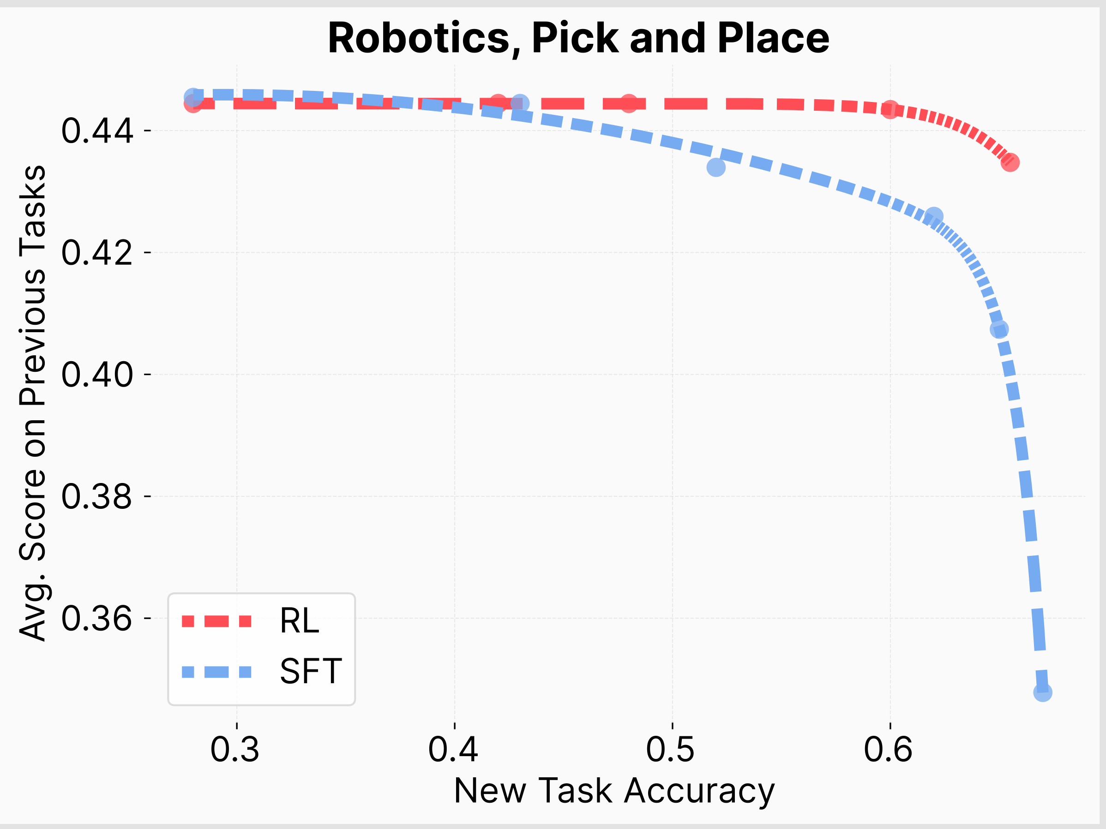
Minimal Forgetting - Results
RL does not forget (on some tasks)!
Notes:
Again same thing happens for Tool Use
Only big difference is that robotics with the pick and place the RL finally loses score on the average
So RL does not forget mostly on some subset tasks is a better interpretation
However honestly i dont like the fact they average up the score on the previous tasks I really want to know what parts are SFT/RL are forgetting

Slide 12
KL Predicts Forgetting - Experiment
Measure Performance on FashionMNIST
SFT or On-Policy RL
“Pretraining”
Finetune on ParityMNIST and FashionMNIST
Model
Train on
ParityMNIST
3 Layer MLP
Measure KL divergence on outputs between base and finetuned on ParityMNIST
Notes:
Keen viewers would see that the curves for forgetting often look the same and there might be some structure to it
They believe that the KL divergence between the output distributions of the finetuned model and the base model on the new task predict forgetting
I.e there is a correlation between this KL divergence and the accuracy of the new task
They do a similar experiment to before
For their model: 3-layer MLP - as it is hard to train an LLM to convergence
Data: “pretrain” on ParityMNIST and FashionMNIST
ParityMNIST- modification of MNIST - instead of predicting the number - the model predicts whether the number is even or odd while allowing for multiple correct output distributions
This means for example they allow you to predict 0, 2,4,6, or 8 as viable answers if the image is of the number 2
Similarly to next word prediction where there are multiple correct next tokens
FashionMNIST - clothing classification - one correct answer - similar to QA benchmarks
Training methods
RL (GRPO): rewards any correct label
Also tries with and without KL divergence added
SFT: trained on arbitrary correct labeling distributons so for example they mapped even to 0 and odd to 1 for one example distribution, the other example distribution they mapped even to 0 and 4 randomly and odd mapped to 1 and 5 randomly
Correct labelling
Just a particular distribution chosen
Oracle SFT: optimal distribution 100% accuracy, minimal KL shift.
Measure Forgetting on FashionMNIST.
Measure: KL divergence between base vs. fine-tuned outputs on ParityMNIST.

Slide 13
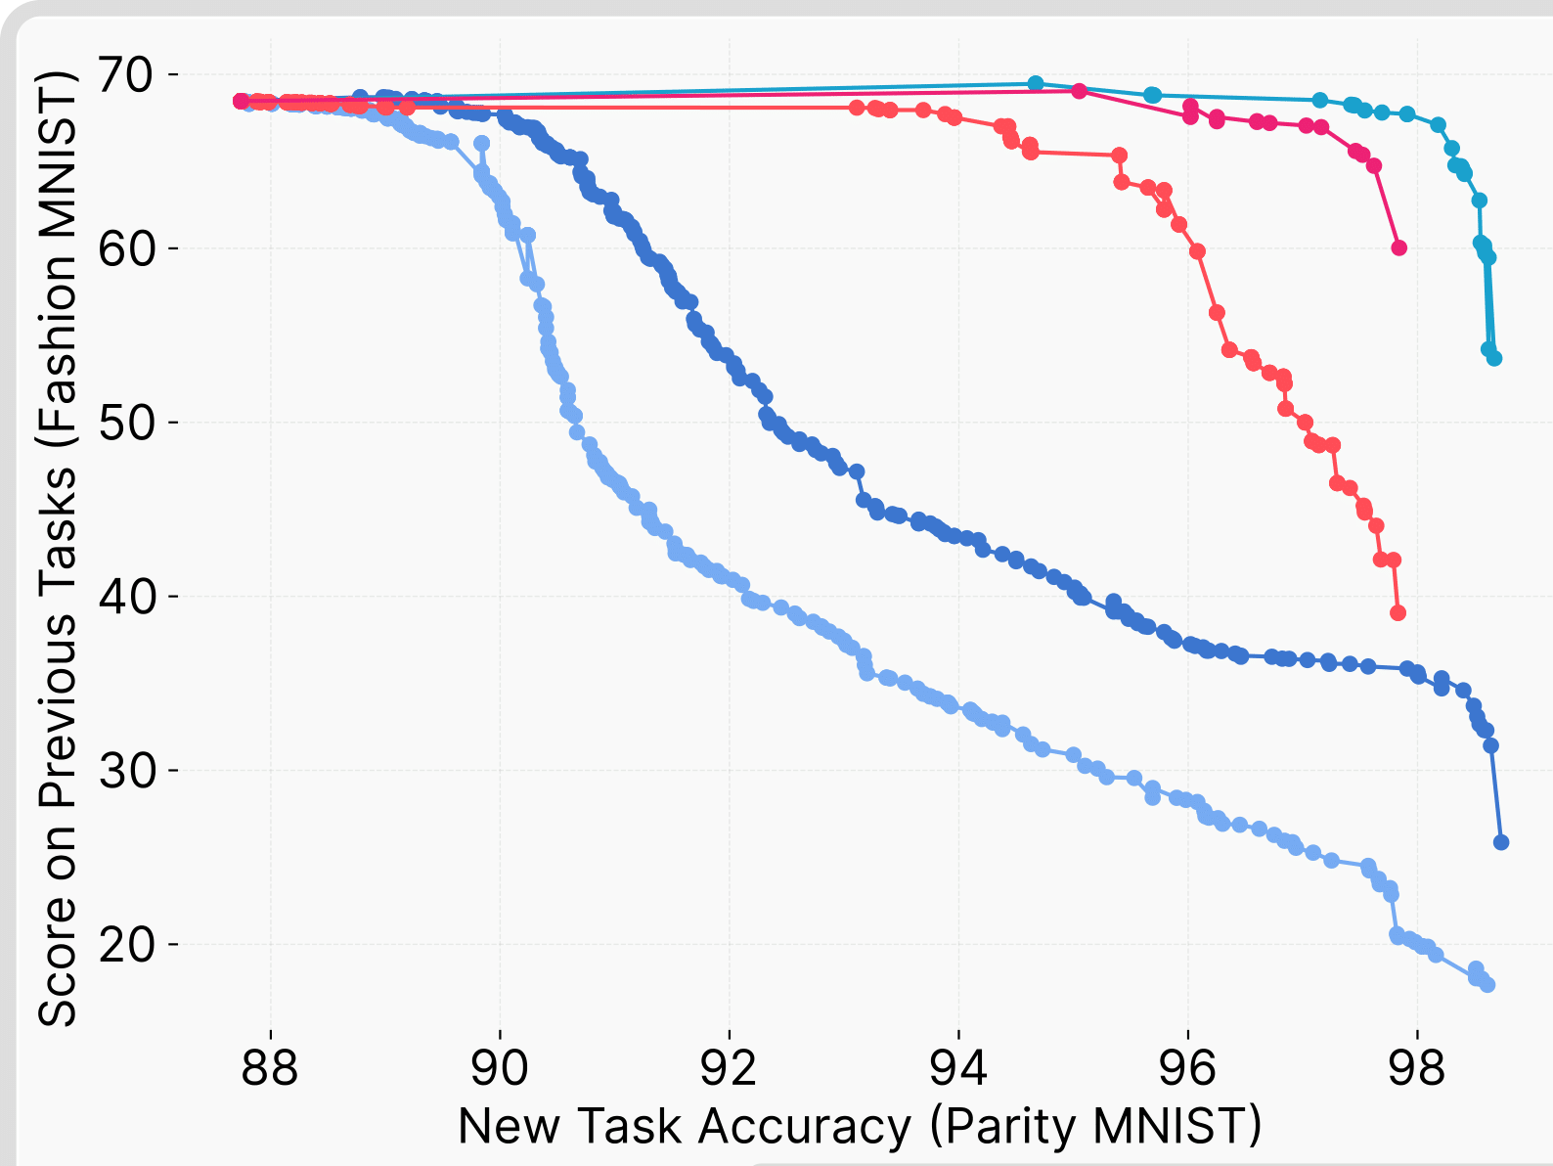
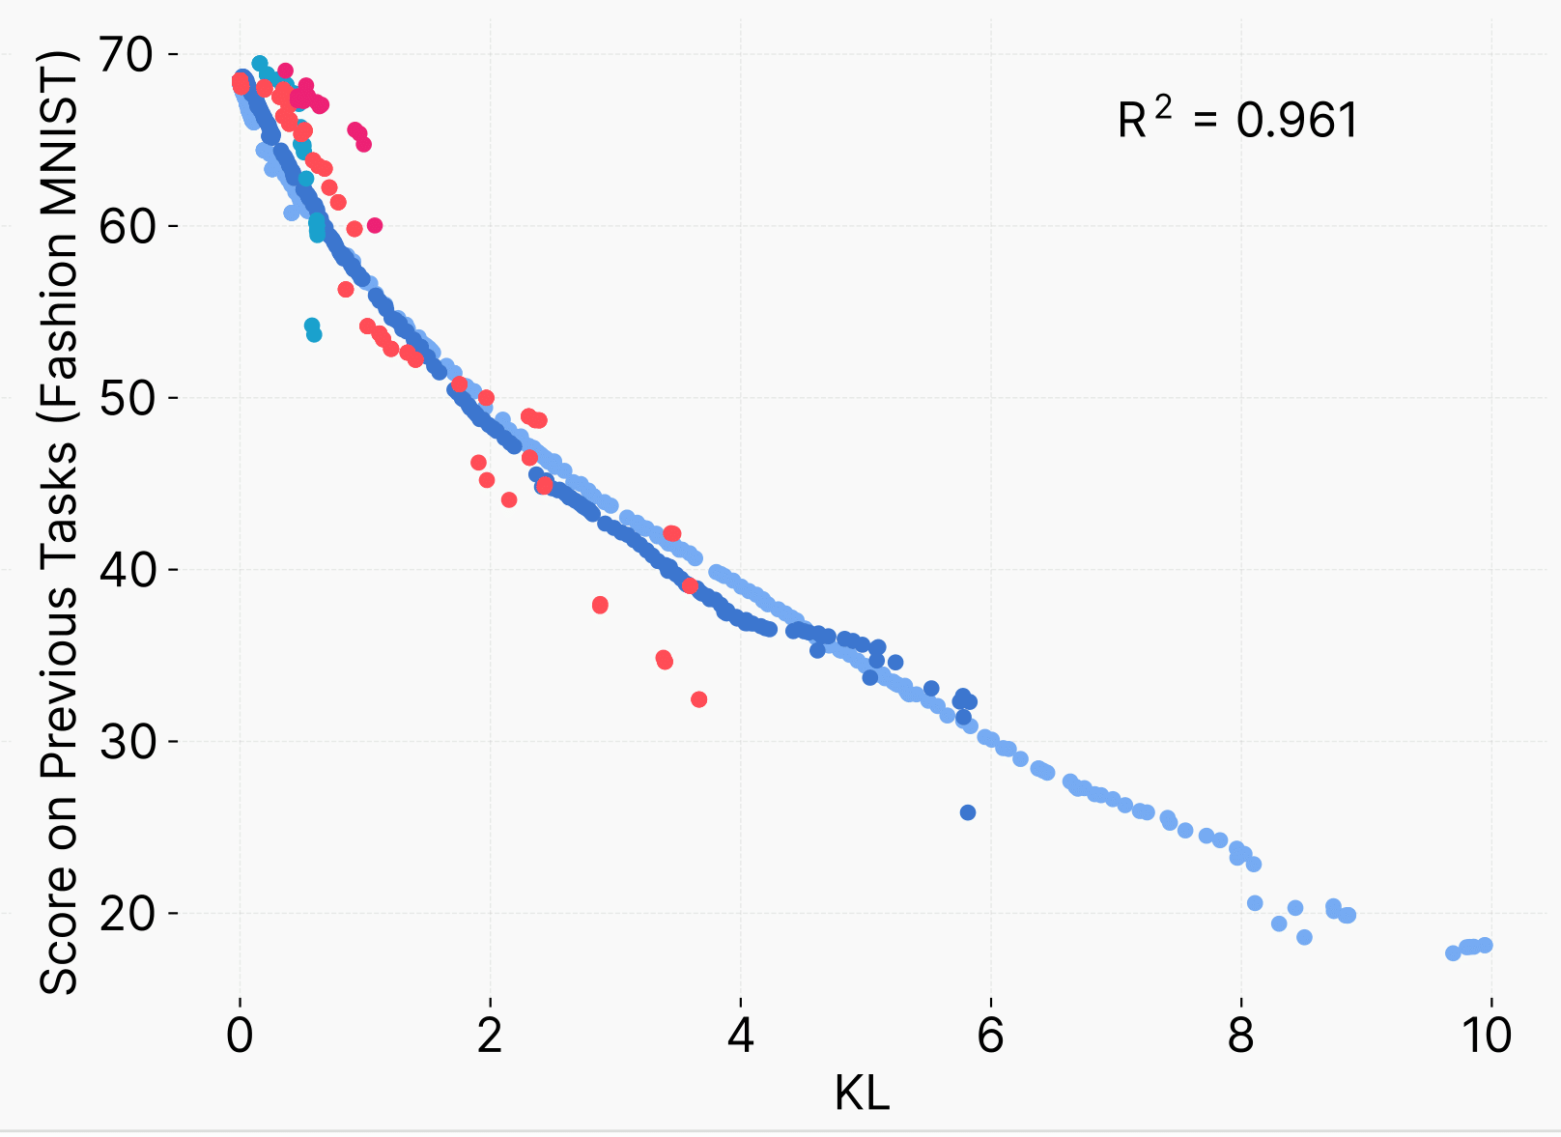
KL Predicts Forgetting - Results
Across algorithms: KL ∝ Score!
Notes:
So here are the training curves
We see that the optimal one does the best as expected with RL + kl regularization and RL being second and both SFTs being the worse in terms for forgetting - predicted what would happen from previous results
But the main thing to focus on is the pretty smooth quadratic curve showing across all training methods that as KL gets larger the score on previous tasks gets smaller with a goodness of fit of 0.961 which is very strong predictor

Slide 14
KL Predicts Forgetting - Results
1.0
0.8
0.6
R^2 (2nd Degree Polynomial)
0.4
0.2
0.0
KL, forward
KL, reverse
TV
Weight change, L1
Activation change, L2
Distribution change, L2
Activation change, L1
Weight change, spectral norm
Weight change, Fisher Weighted L2
Notes:
You might think what about other predictors
They compared their idea of KL divergence to multiple other ideas that other authors said
They compared to Activation Change
Weight change
L2 distance between distributions
Total Variation - another distribution distance
And then finally KL
However, they only test the R^2 on 2nd degree polynomials for all them which is an interesting choice that might bias their results to KL divergence

Slide 15
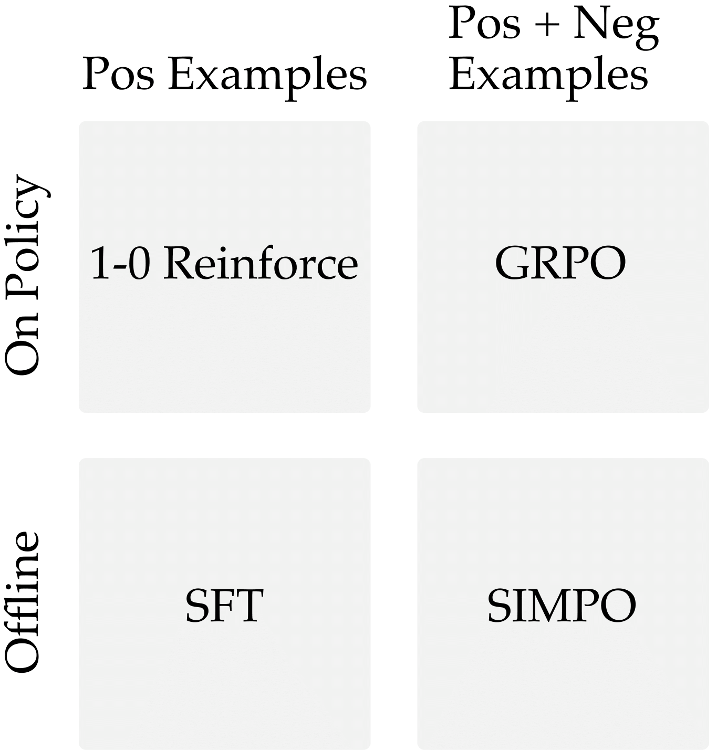
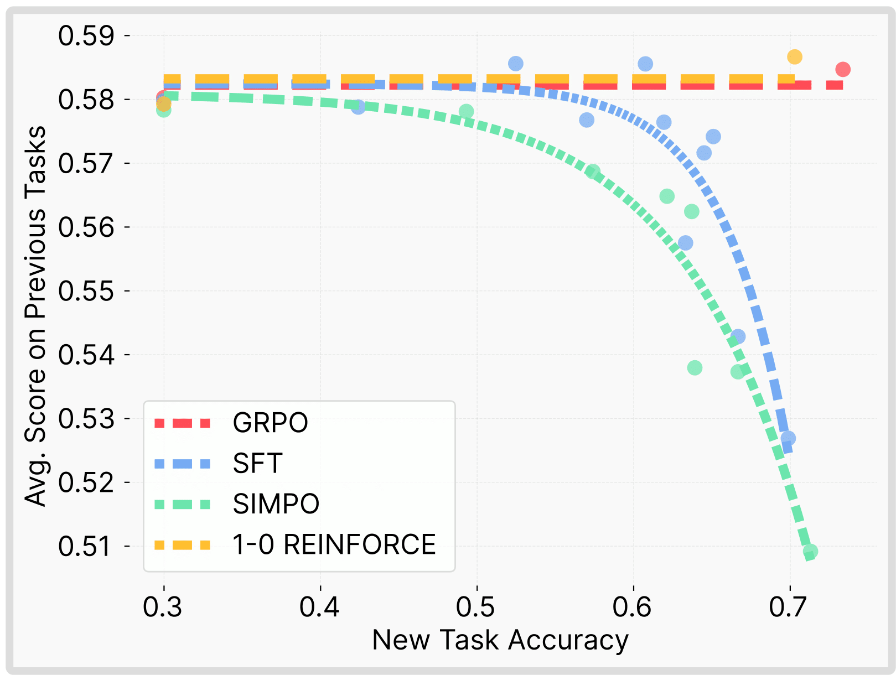
On-Policy > Everything - Empirical
Notes:
Now they finally ask why does it work like this, to experiment this they tried 2 more algorithms: 1-0 reinforce and SIMPO on the science QA datasets
1-0 reinforce is just where the correct answers are 1 and the incorrect ones are 0 reward
SIMPO is very similar to DPO - its an off policy RL method
The same curves pop up for SFT and SIMPO
But not for reinforce
It seems that being on policy its a good reason why there is less forgetting

Slide 16
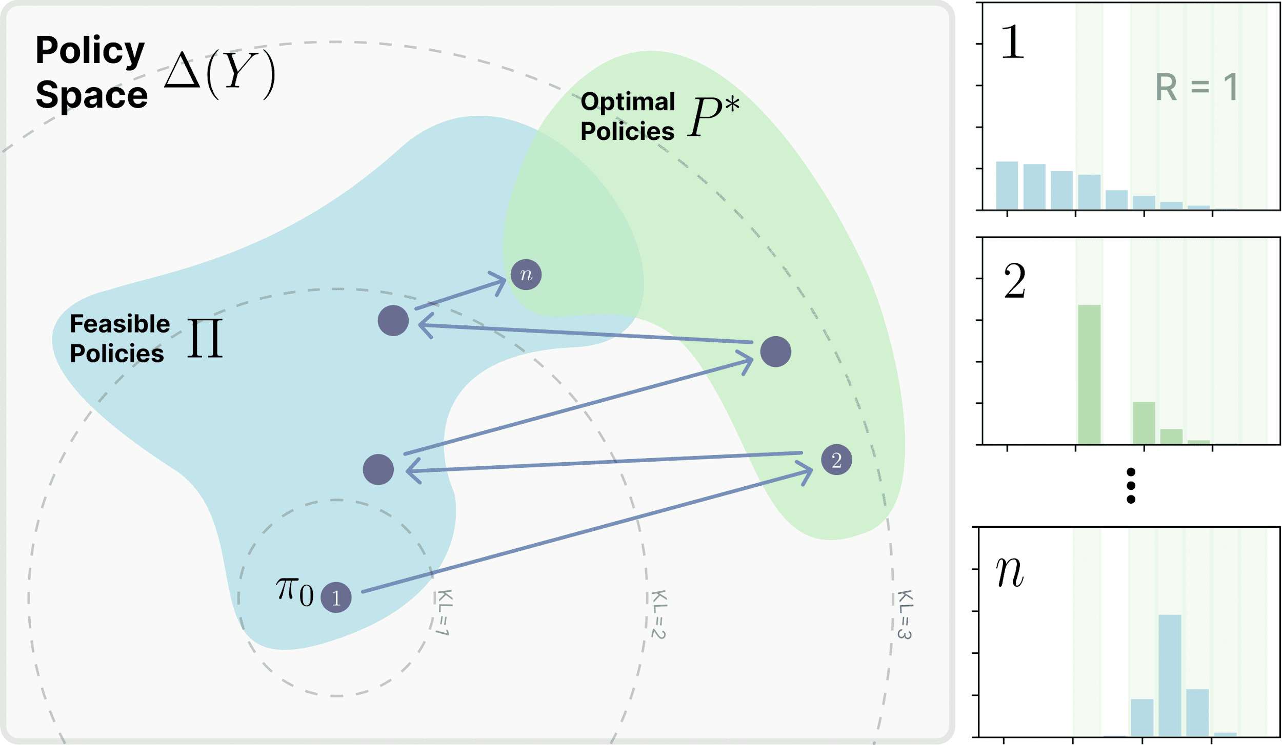
On-Policy > Everything - Theory
Policy gradient keeps closer to base model
Reweights likely outputs → shifts mass to higher reward
Updates relative to own distribution → small, local KL shift
Notes:
They dive into some theory that might explain this phenomenon that is a little too high level but they have a general explanation that might be nice
On policy methods keep the policy closer to the base model -> i.e having lower KL
The policy samples outputs it already considers likely then reweighted by rewards
Probability mass shifts towards higher rewards and high probability while lower reward high probability are suppressed and lower probability outcomes are suppressed implicitly
It nudges the distribution in the right way and are relative to the base distribution and rather than SFT which forces it to a distant distribution

Slide 17
Conclusion (Convinced?)
On-policy RL has minimal catastrophic forgetting in comparison to off policy RL and SFT
KL divergence has a strong correlation with catastrophic forgetting
On-policy training drives the advantage theoretically and empirically

Slide 18

SFT Memorizes, RL Generalizes: A Comparative Study of Foundation Model Post-Training
Tianzhe Chu, Yuexiang Zhai, Yihan Yang, Shengbang Tong, Saining Xie, Dale Shuurmans, Quoc V. Le, Sergey Levine, Yi Ma
Notes:
]

Slide 19
Paper Introduction
Research question – what effects do post-training methods like RL and SFT have on a model’s ability to generalize?
The authors investigate by post-training and evaluating models on different variants of both text-only and multimodal tasks
rule-based variants
visual distribution variants
Notes:
authors claim that this is challenging to analyze because we must distinguish generalization from memorization
separate data memorization from the acquisition of transferable principles
how do we identify the two / know when each is happening?
one direct way to tackle this is have a model engage with two distinct variant of the same task
train on one variant
and then evaluate on a different OOD variant.
in particular, they choose an OOD variant such that, being proficient at the training variant conceptually implies that you should be proficient at the new variant as well.
they carry this out on two axes of variation: variation of textual rules, and variation of visual distribution

Slide 20
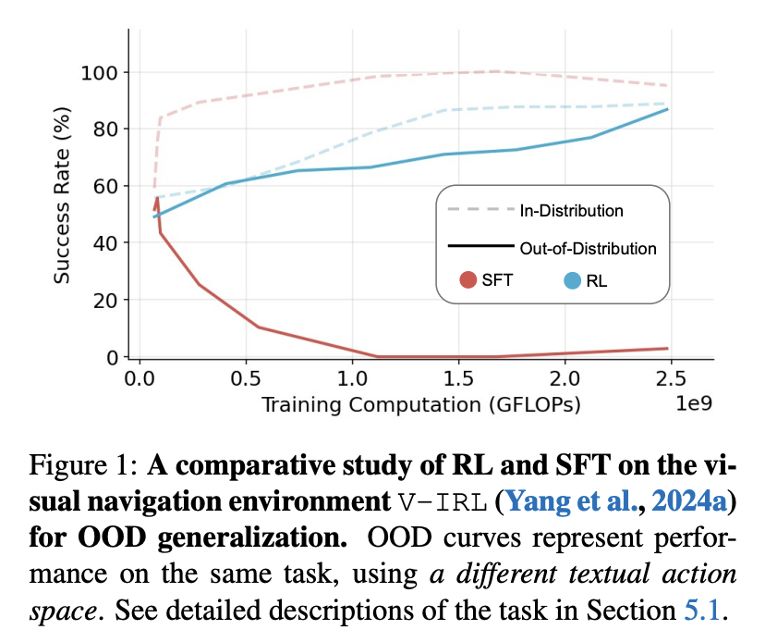
Findings
RL proficiently generalizes across both variant axes, while SFT does not
SFT is still crucial prior to RL to stabilize model outputs & instill instruction- following ability
increasing # of verification steps => better generalization
Notes:
the authors find that models trained under RL generalize quite proficiently, while models trained under SFT are significantly less successful
they also present some secondary findings
SFT still holds importance on helping a model get its feet off the ground, so to speak
the more frequent the verification during RL (or feedback from the environment), the better the generalization

Slide 21
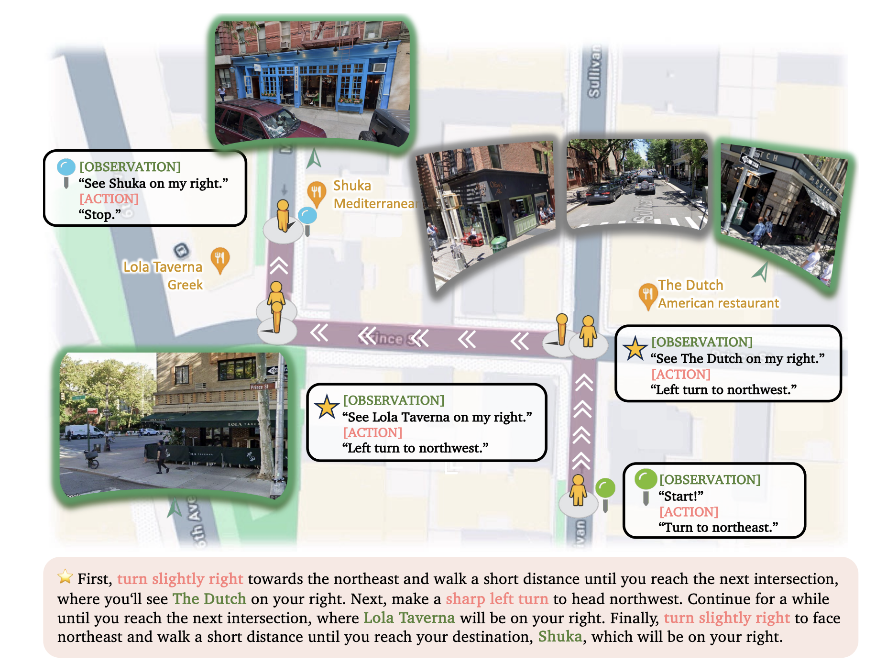
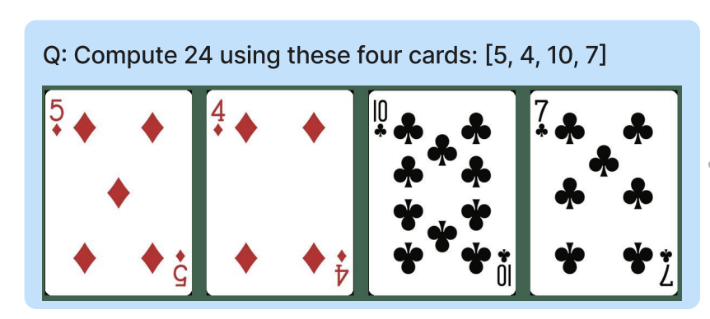
Evaluation Tasks
V-IRL
takes place in V-IRL environment (Yang, 2024a)
Goal: given set of instructions containing spatial info, navigate to a target location in the world
task modalities:
V-IRL-L: info w.r.t. notable landmarks near the agent are automatically provided
V-IRL-VL: vision input provided at every timestep - agent is tasked w/ visual recognition
GeneralPoints (GP)
A more general version of Points24
Goal: given 4 cards, produce an equation that equals a target number (e.g. 24)
task modalities:
GP-L: input = description of 4 cards
GP-VL: input = an image of 4 cards laid out
Notes:
general points
like points24
goal: produce an equation using 4 cards to get a target number
distinction
V-IRL
takes place in V-IRL, a virtual playground with replicas of real cities
goal: follow a set of instructions containing spatial information to navigate to a target location
distinction:
V-IRL-L handles visual recognition for you (observations are text-based descriptions of nearby landmarks)
V-IRL-VL - you are provided pictures for your observations and must recognize landmarks yourself

Slide 22
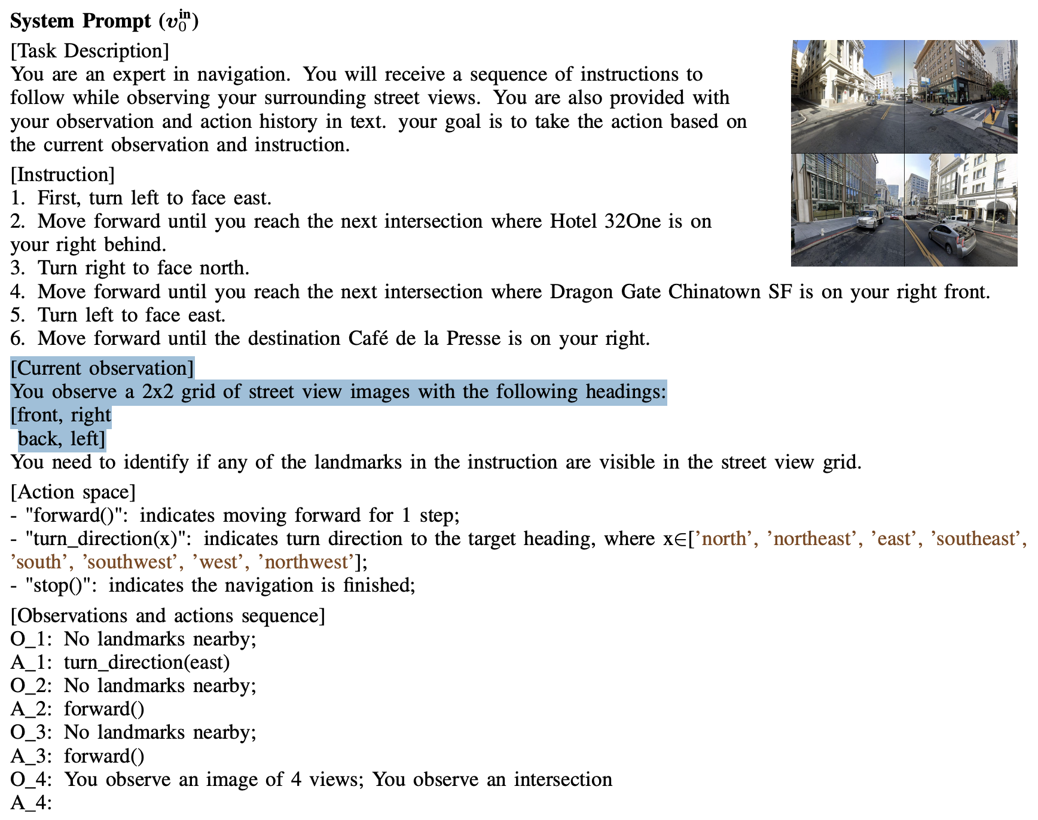
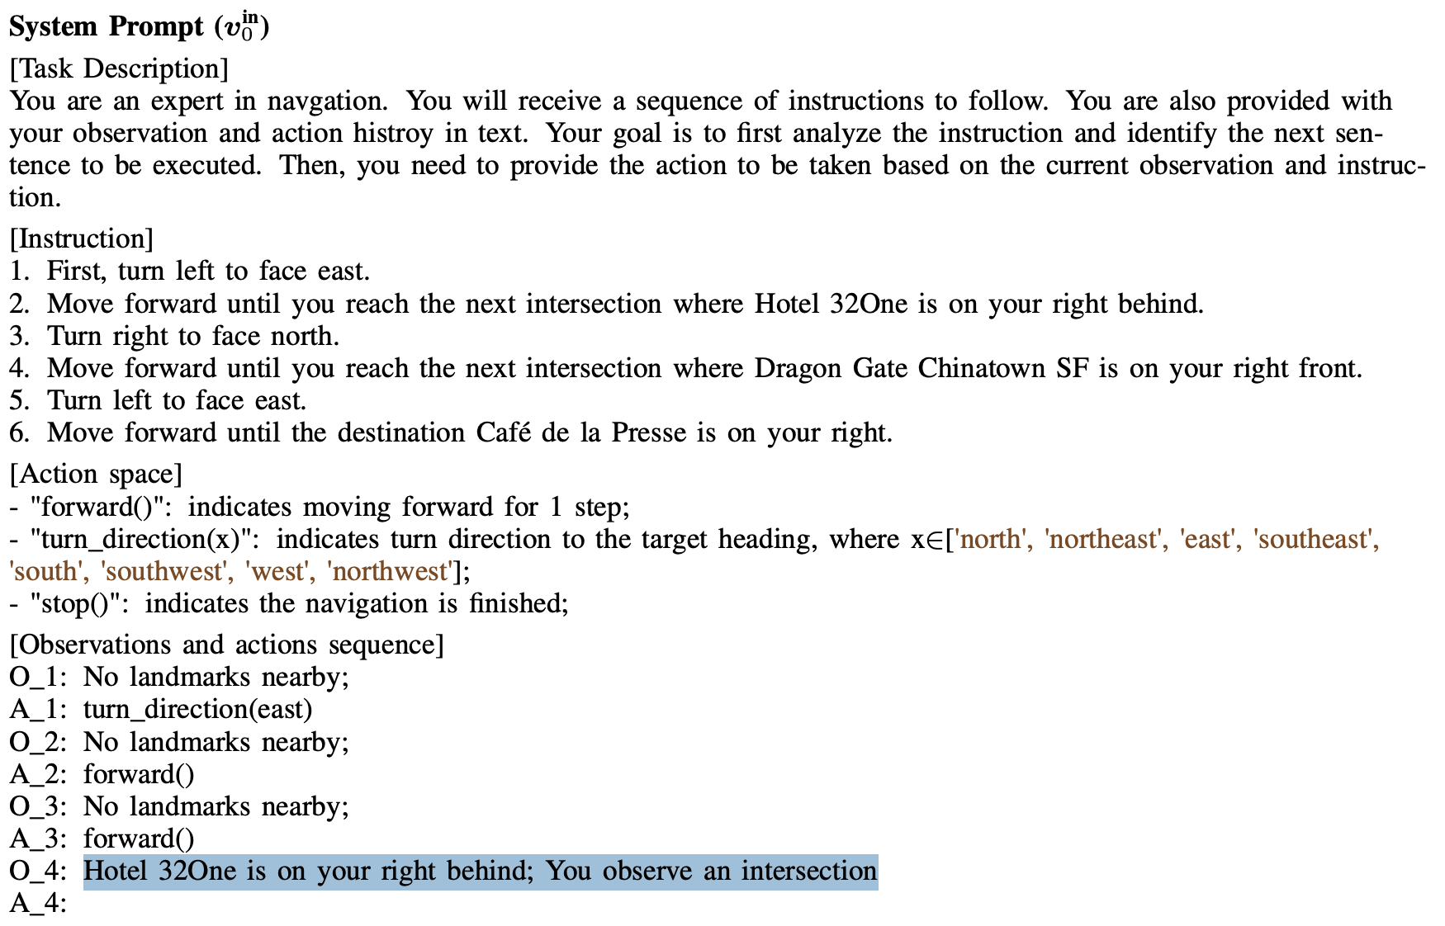
Takeaway: V-IRL-VL adds visual recognition to the task, whereas V-IRL-L handles it for you
Notes:
V-IRL-VL - provides “current observation” as the images, and references them in the obs/action sequence. agent must do visual recognition
V-IRL-L - provides description of noteworthy landmarks in the obs/action sequence

Slide 23
Task Variants
Points24
Rule-Based Variants
ID: “absolute orientation” action space
A ∈ [north, northeast, east, …]
OOD: “relative orientation” action space
A ∈ [left, right, slightly left, slightly right]
Visual Variants
ID: routing tasks from in New York City
OOD: routing tasks collected in various cities around the world
GeneralPoints
Rule-Based Variants
In-distribution (ID): J, Q, K = 11, 12, 13
Out-of-distribution (OOD): J, Q, K = all 10
Visual Variants
ID: cards are all black suits
OOD: cards are all red suits
Notes:
for each game, we make pairs of variants of the game across two different axes: rule-based variants and visual variants
of note: the OOD variants are all different in ways where the learnings of the ID version are very transferable by design
for example, for the visual variants of GeneralPoints, the bulk of the visual work is by processing the numbers on the cards, so the color of card suits should in theory not have any effect on performance

Slide 24
Results

Slide 25
Results - Generalization Across Rules
authors measured delta of performance on each task’s OOD variant after applying RL or SFT
findings:
RL - significant gains
SFT - catastrophic losses
 | RL | SFT
GP-L | +3.5 (11.5 → 15.0) | -8.1 (11.5 → 3.4)
V-IRL-L | +11.0 (80.8 → 91.8) | -79.5 (80.8 → 1.3)
GP-VL | +3.0 (11.2 → 14.2) | -5.6 (11.2 → 5.6)
V-IRL-VL | +9.3 (35.7 → 45.0) | -33.2 (35.7 → 2.5)
Notes:
“additional layer of post-training” - worth mentioning that there is an initial round of SFT

Slide 26
Results - Generalization in Visual OOD Tasks
authors measured delta of performance on each task’s OOD variant after applying RL or SFT
findings:
RL - significant gains
SFT - catastrophic losses
 | RL | SFT
GP-VL | +17.6 (23.6 → 41.2) | -9.9 (23.6 → 13.7)
V-IRL-VL | +61.1 (16.7 → 77.8) | -5.6 (16.7 → 11.1)
Notes:
“additional layer of post-training” - worth mentioning that there is an initial round of SFT

Slide 27
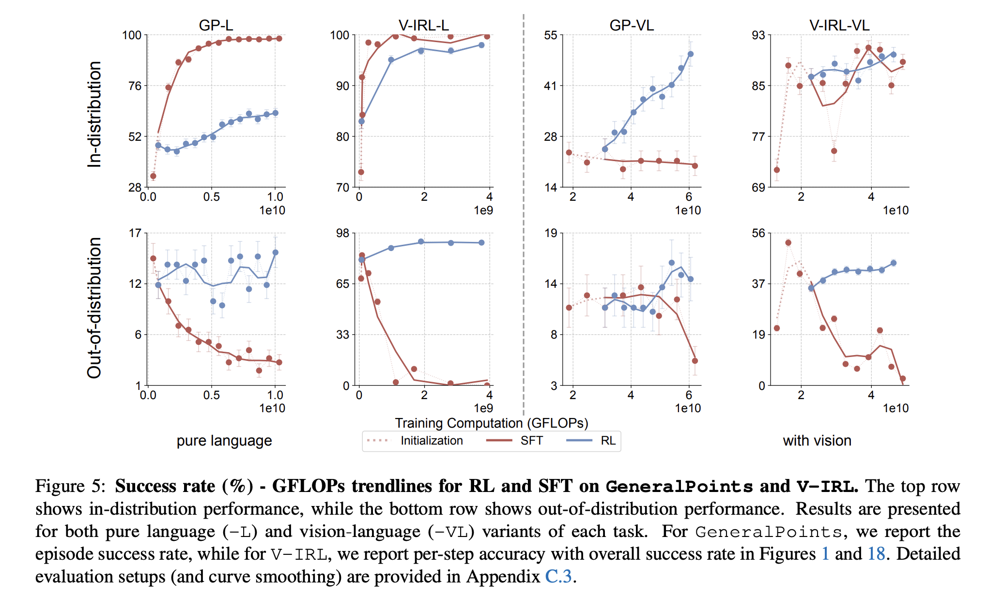
Notes:
interesting – SFT actually does better at the task for in-distribution text-only
hyp: more memorize-able than VL tasks?
for out-of-distribution SFT always goes down

Slide 28
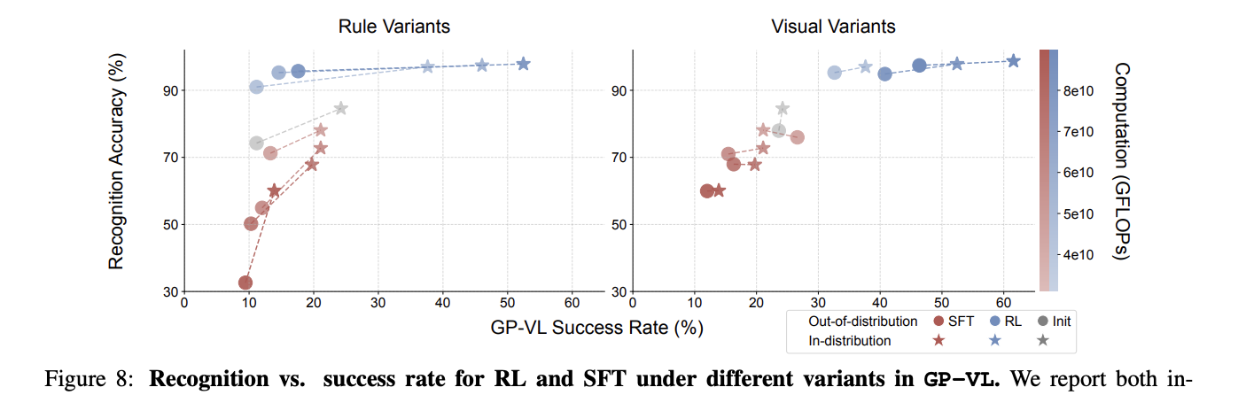
Analyzing Visual Recognition Accuracy
correlation between success and accuracy
trajectory of different colors
relative horiz. position of circles / stars
relative vert. position of circles / stars
Notes:
axes here:
GP-VL success rate - x-axis
recognition accuracy - y-axis
training compute - color gradients
shape - in or out of dist
note: generalization = how close the circles are to the stars
takeaways:
visual recognition and task proficiency seem to be correlated
blue and red pairs go in opposite directions as they get darker
more compute => better performance for RL, worse performance for SFT
init. is kinda a midpoint
OOD: as colors get darker, blue circles go up (OOD improves with RL) and red circles go down (OOD worsens with SFT)
note: expected that circles are to the left of stars (OOD should be worse than ID)
RL: stars and circles on the same line => as we train, the stars and circles level out => recognition accuracy starts to generalize (opposite for SFT)
generalization
interesting: OOD visual recognition plummets, but
rule variants of GP-VL - as we train visual recognition on one ruleset, visual recognition with another ruleset goes down?

Slide 29
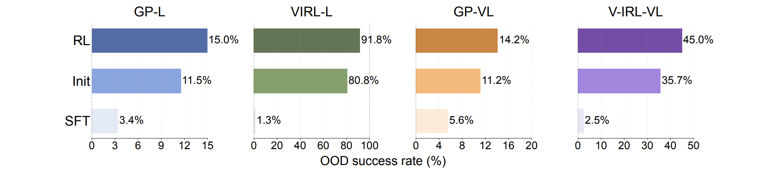
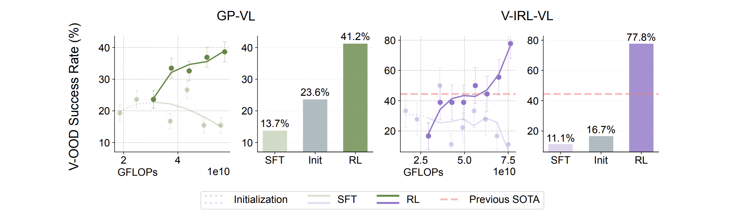
Rule-based:
Visual-based:
Notes:
33.8% increase from state of the art on V-IRL-VL

Slide 30
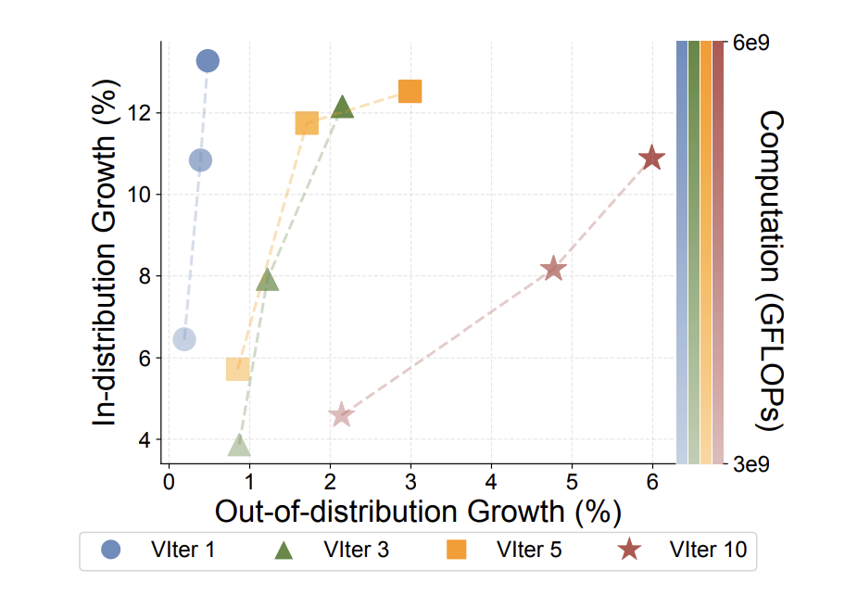
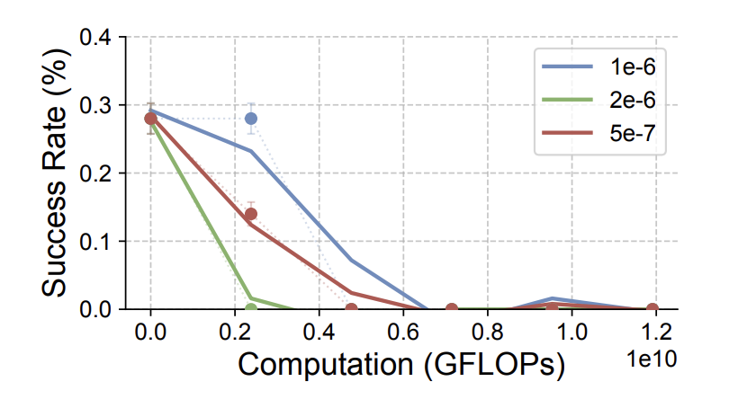
Other Results
RL generally improves visual capabilities (esp. visual recognition)
SFT is still necessary to stabilize outputs prior to RL
More verification steps => better generalization through RL
Notes:
if we omit an initial round of SFT, the models don’t learn to formulate their outputs correctly and can’t get off the ground to obtain reward signal to accomplish the task.

Slide 31
Conclusion
This paper finds that, in both language-based and multimodal settings, RL exhibits a positive effect on generalization, while SFT appears to bring about pure memorization.

Slide 32
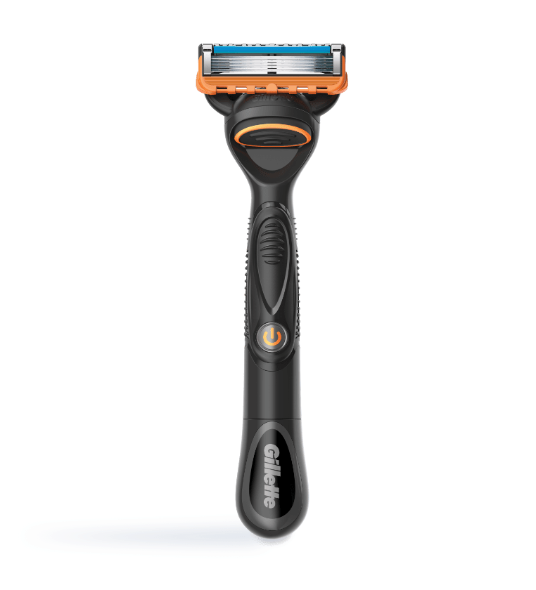
Which result is more convincing?
Are they even convincing in the first place?
How do we explain these results?

